Slide 1
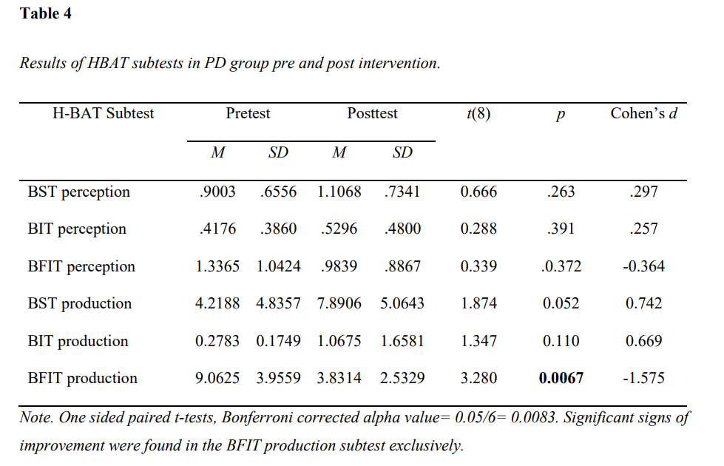
The effect of rhythm intervention in Parkinson's Disease (PD)
Marie Bjerkvik and Håvard H. Hugaas University of Bergen
bif009@uib.no hhu007@uib.no
This intervention study assessed the effects of having 6 weeks of bimanual drumming lessons, using the Unified Parkinson's disease rating scale (UPDRS) and the Harvard Beat Assessment Test. The PD group showed a greater improvement from the production part of the Beat Finding Interval Test (BFIT), which can be argued to have a greater demand for motor flexibility, making it highly relevant to PD symptomatology.
ABSTRACT
This intervention study assessed the effects in patients with PD of having 6 weeks of bimanual drumming lessons, using the Unified Parkinson's disease rating scale (UPDRS) and the Harvard Beat Assessment Test.
The PD group showed a greater improvement in the production part of the Beat Finding Interval Test (BFIT) exclusively, which can be argued to have a greater demand for motor flexibility, making it highly relevant to PD symptomatology.
Method
8 participants with PD were recruited and matched with 3 healthy control participants, all having the same intervention. Prior to and post intervention the participants were tested on motor symptoms and other PD symptoms related to mental status, cognitive functions, activities of daily living (ADL) and pharmacological side effects using the Unified Parkinson's disease rating scale (UPDRS), and rhythmic perception/production using the Harvard Beat Assessment Test (H-BAT)
Results
Participants with PD had a lower score pre intervention, but a greater improvement post intervention, when comparing their results from the production part of the Beat Finding Interval Test (BFIT) in the H-BAT with the control group. The other subtests in the H-BAT did not show significant improvement. The UPDRS motor symptom assessment showed no signs of improvement.
Conclusion
Having a 6-weeks period of drum interventions improved patients with Parkinson's Disease ability to find and produce a beat, as well as adapting timed motor activation to changes in the beats as presented to them.
This could have a connection to the greater demands on motor flexibility in this task specifically, which makes the improvement highly relevant to PD symptomatology, though the UPDRS motor score did not point to improvement in pure motor symptoms.
An improvement of motor behavior may improve functioning in daily living, which may in turn represent both a greater independence, and increased quality of life.
ACKNOWLEDGEMENTS
Kjetil Vikene, postdoktor ved Institutt for biologisk og medisinsk psykologi (IBMP) ved Universitetet i Bergen
Geir Olve Skeie, PhD og nevrolog ved Haukeland Universitetssykehus

