Slide 1
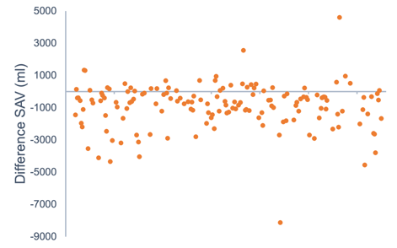
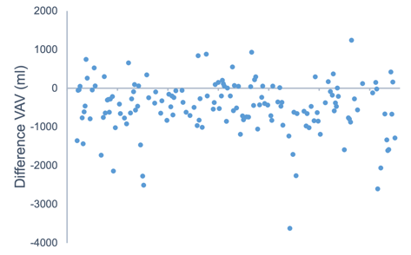
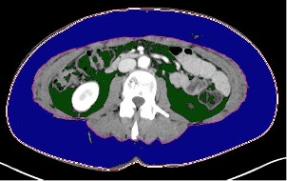
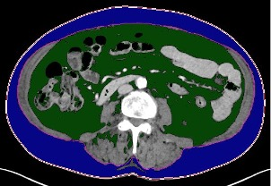
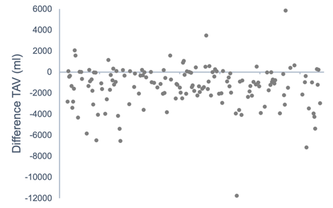
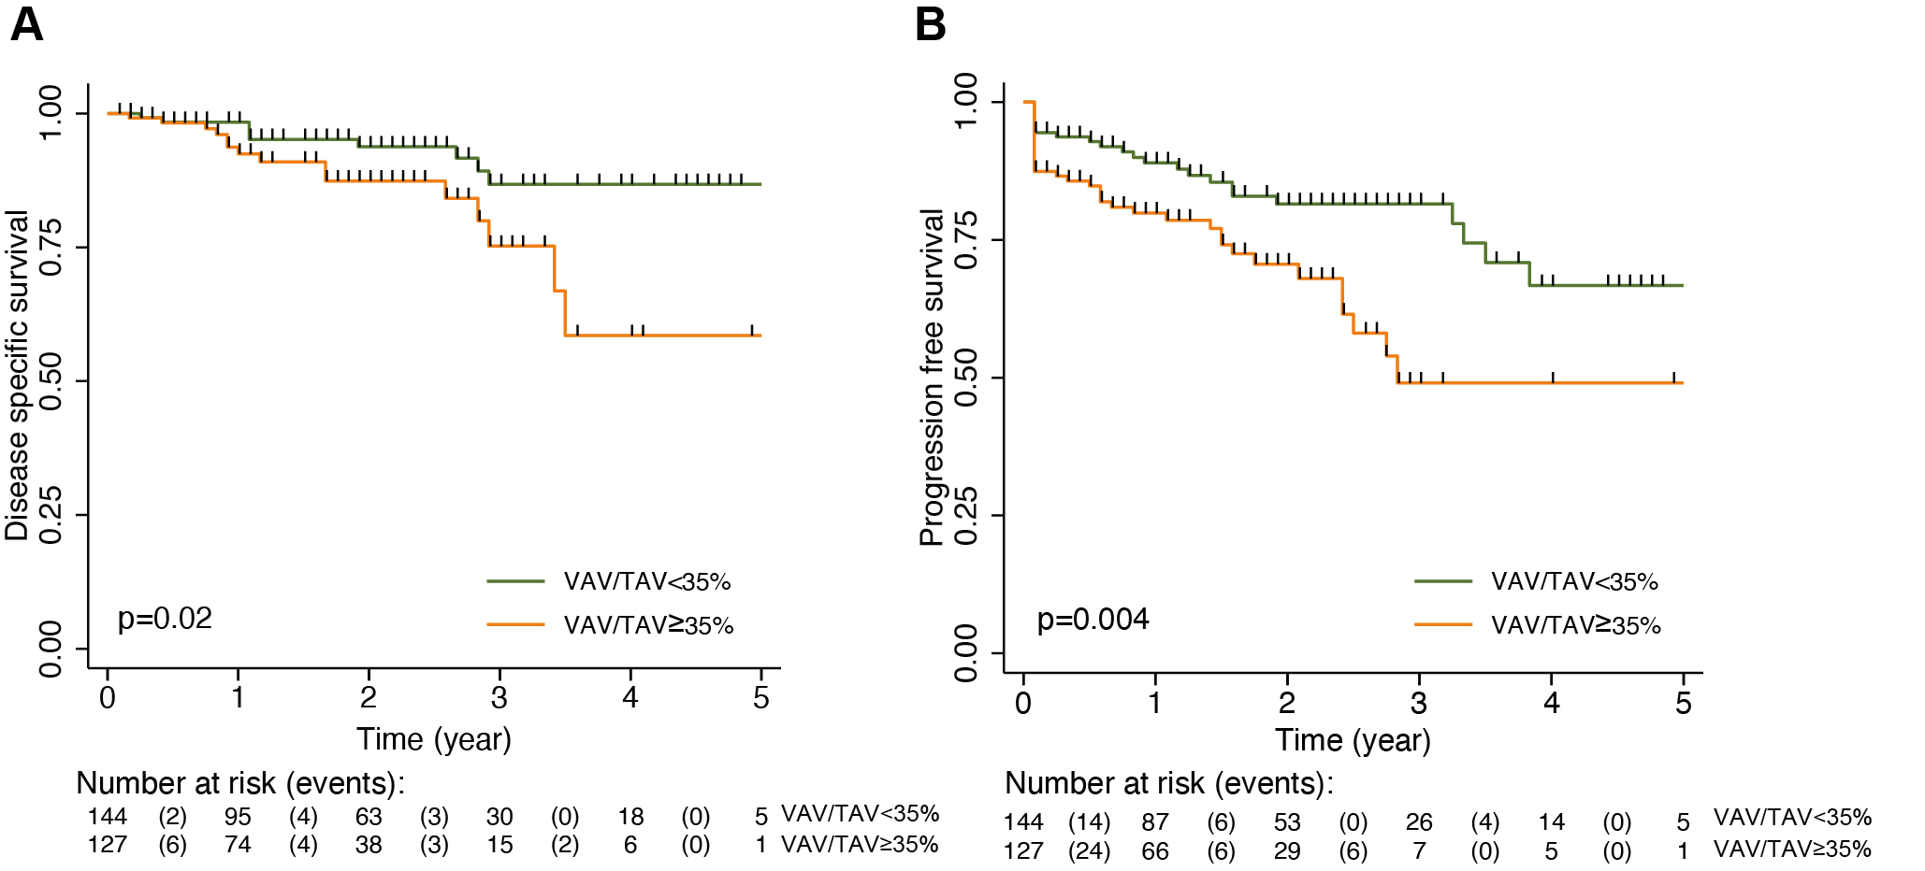
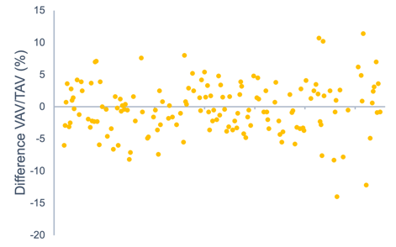
Visceral fat and survival in endometrial cancer
High visceral fat percentage is associated with high-risk disease, reduced disease-specific and progression-free survival in EC patients. At CT follow-up, most patients had reduced total abdominal fat volumes while visceral fat percentage was unaffected.
Astrid M. K. Brun and Maria B. S. Ljunggren
University of Bergen
qif008@uib.no, mlj001@uib.no
ABSTRACT
Background: Endometrial cancer (EC) is a common cancer worldwide, with a strong link to obesity^{1,2}. Our aim was to explore the prognostic impact of fat distribution and possible changes in fat at CT follow-up.
Method: Abdominal fat volumes were quantified on CT scans for 293 EC patients. Subcutaneous (SAV), visceral (VAV), total (TAV) and visceral fat percentage (VAV/TAV) were measured and analyzed in relation to clinicopathological features.
Results: Higher VAV/TAV was associated with histologically high-risk disease. No association was seen between FIGO stage and the morphometric obesity markers. High VAV/TAV was significantly associated with reduced disease-specific and progression-free survival (Figure 1). At CT follow-up most patients had reduced SAV, VAV and TAV, while unaffected VAV/TAV.
Conclusion: Our findings suggest that VAV/TAV could be implemented as a novel prognostic factor in EC diagnostic.
Endometrial cancer
EC is histopathologically subdivided into type 1 or low-risk tumors, and type 2 or high-risk tumors by biopsy sampling. Staging is done surgically by FIGO, stages I-IV. Most patients present with early symptoms of abnormal bleeding, low-risk histology and FIGO stage I-II, giving them good prognosis¹. Overall prognosis is ca. 80%³.
Subcutaneous and visceral fat
Obesity is a well-known risk factor for developing EC¹. Obesity is usually defined by BMI, although this parameter does not distinguish between different tissues. Subcutaneous and visceral fat differ in metabolic activity, insulin resistance, inflammatory potential and more, and visceral fat is often referred to as the “unhealthy fat” and believed to have a more carcinogenic profile⁴⁻⁷.
Figure 3
VAV/TAV unaffected by BMI
Spearman rho was used to explore correlations between the morphometric obesity markers (BMI, SAV, VAV, TAV, VAV/TAV). All markers except VAV/TAV were highly positively correlated with each other. The lack of correlation between VAV/TAV and BMI indicates that the patients individual fat distributions are independent of the patients weight/BMI.
High-risk disease and VAV/TAV
Associations between morphometric obesity markers and clinicopathological features were calculated using the Man Whitney U test. We found that high-risk disease had significantly lower BMI, SAV and TAV, but higher VAV/TAV. Obesity is well established to increase risk of developing EC and our findings suggest that the different fat compartments have distinct carcinogenic potentials.
Reduced disease-specific survival
Using Cox Proportional Hazard Regression model, we found that VAV/TAV was significantly associated with reduced disease-specific and progression-free survival (Figure 1), substantiating the proposition that visceral fat has a more carcinogenic profile⁴⁻⁷.
Changes in fat volumes postoperatively
Figure 3 shows changes in the morphometric obesity markers postoperatively. VAV/TAV had hardly changed for most patients, indicating fat loss was equal in SAV and VAV. It is well established that VAV is more sensitive to weight loss than SAV⁴, suggesting fat loss due to cancer and cancer treatment might differ from intentional weight loss.
Figure 2
A
B
A: BMI: 27,2, VAV: 1158 ml, SAV: 5742 ml, TAV: 6900 ml, VAV/TAV: 17%
B: BMI: 27, VAV: 4430 ml, SAV: 4381 ml, TAV: 8811 ml, VAV/TAV: 50%
Figure 1
Fatty tissue quantification (Figure 2)
293 patients with primary EC and preoperative CT scans were included. SAV (blue) and VAV (green) were quantified, TAV and VAV/TAV calculated. 153 patients had follow-up scans and comprise the follow-up group.
Figure 2 illustrates that two persons with comparable BMI (27,2 and 27) can have vastly different fat distributions.
REFERENCES
Morice PDP, Leary AMD, Creutzberg CP, Abu-Rustum NP, Darai EP. Endometrial cancer. Lancet. 2015;387(10023):1094-108.
Shaw E, Farris M, McNeil J, Friedenreich C. Obesity and Endometrial Cancer. Obesity and Cancer. 2016:107-36.
Creasman WT, Odicino F, Maisonneuve P, Quinn MA, Beller U, Benedet JL, et al. Carcinoma of the Corpus Uteri. Int J Gynaecol Obstet. 2006;95:S105-S43.
Ibrahim MM. Subcutaneous and visceral adipose tissue: structural and functional differences. Obes Rev. 2010;11(1):11-8.
van Weelden WJ, Fasmer KE, Tangen IL, IntHout J, Abbink K, van Herwaarden AE, et al. Impact of body mass index and fat distribution on sex steroid levels in endometrial carcinoma: A retrospective study. 2019.
Donohoe CL, Doyle SL, Reynolds JV. Visceral adiposity, insulin resistance and cancer risk. Diabetology & Metabolic Syndrome. 2011;3(1):12.
Mauland KK, Eng ØAS, Ytre-Hauge S, Tangen IL, Berg A, Salvesen H, et al. High visceral fat percentage is associated with poor outcome in endometrial cancer. 2017.
ACKNOWLEDGEMENTS
The authors would like to thank Ingfrid S. Haldorsen for guidance, and Kristine E. Fasmer for guidance and technical support. Thank you to Mohn Medical Imaging and Visualization Centre for a pleasant and supportive working environment.

