Slide 1
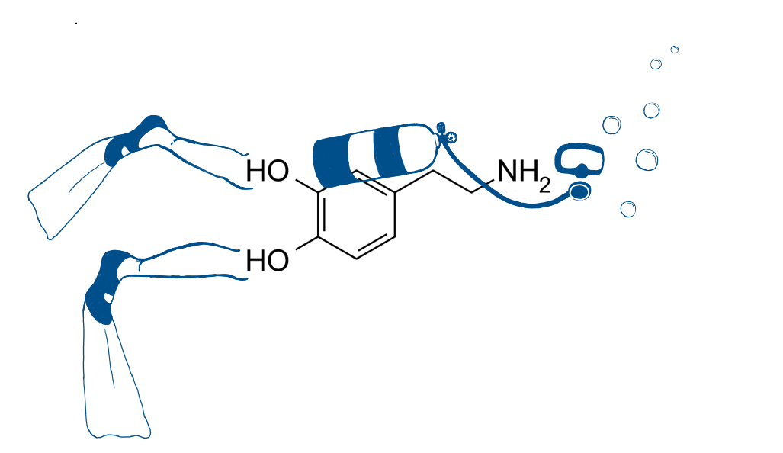
Dopamine under pressure
Marte Elise Eide
Marie Ryen Brabec University of Bergen
fac009@uib.no
gun008@uib.no
A literature study on the effects of diving-conditions on dopaminergic neurotransmission and possible implications for improved safety of occipational diving
Abstract
This literature study examines the reported effects diving-related exposures have on the monoamine dopamine in the brain. Studies have shown that monoamines play a crucial role in pressure related diving complications like high-pressure neurological syndrome and inert gas narcosis. Elucidating the role of dopamine can lead us closer to a mechanistic understanding of how inert gasses and pressure affect the central nervous system. A deeper understanding of these conditions can lead to strengthening of guidelines and improved safety for divers. It can also address conflicting areas such as possible long-term effects of diving on the nervous system.
To get an overview over all the research done on the neurotransmitter dopamine in relation to the conditions inert gas narcosis and high pressure neurological syndrome we used the search engine PubMed to collect all the relevant findings done on the subject. The search included an amount of 24 relevant and retrievable studies, from the year 1980 to 2021. We found that after over four decades of research the number of studies done on the subject are few and highly dominated by a handful of research groups. The use of both model systems and methods are highly homogenous. 21 of 24 studies measured dopamine directly inside the striatum in male rats. The current knowledge is that hyperbaric N₂ decreases dopamine in the rat striatum and hyperbaric He increases dopamine. The dopamine changes measured could be manipulated by various receptor agonists and antagonists. This implicates that these pressure related diving complications can possibly be treated.
Dopamine under pressure – A selecton of our findings
Factors | Tyrosine | DA | DOPAC | HVA
Nitrogen under pressure | ↑ | ↓ | ↑ | ↑
Nitrogen under pressure + NMDA agonist |  | ↑ | → | ↓
Nitrogen under pressure + NMDA antagonist |  | ↑
Nitrogen under pressure + GABA_{B} antagonist |  | ↓ | ↓ | →
Helium under pressure | ↓ | ↑ | ↑ | ↑/→
Helium under pressure + 5-HT receptor agonists OR 5-HT receptor antagonists |  | ↓
Helium under pressure + D1/D2 receptor agonist |  | ↓
Helium + 5-HT1b receptor antagonist + β-adrenergic receptor agonist |  | ↓

