Slide 1
Navigate the web pages
The PhD programme at the Faculty of Social Sciences

Slide 2


Quick address to the faculty pages
Choose preferred language
All programme information is in both norwegian and english!

Slide 3
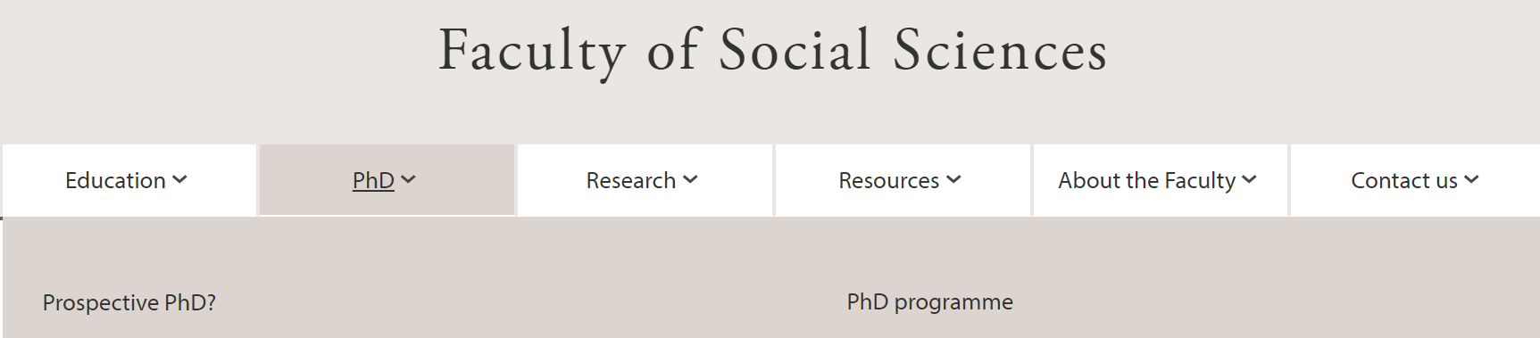
1
Two paths
Path 1
Path 2
Recruitment
Vacant PhD fellowships
Admission information
Application form
Regulations
Training component
Progress elements
About the thesis
Supervision
Internationalization
Submission
Career
And more…

Slide 4

Path 1
Information meant for prospective candidates.
This information is useful to know about for supervisors.

Slide 5
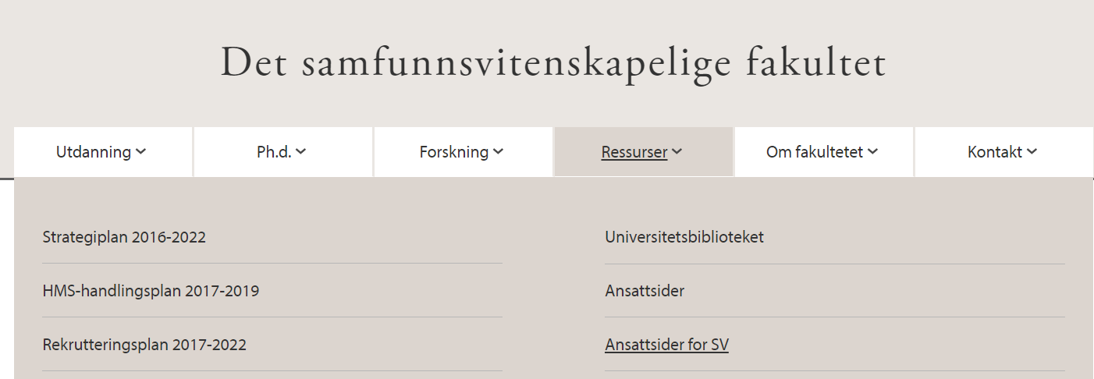
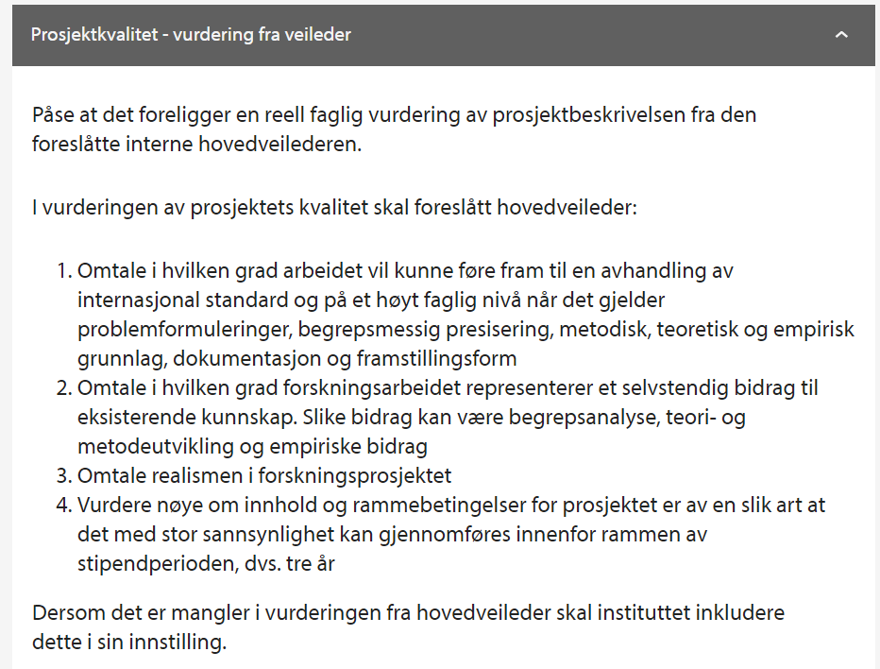
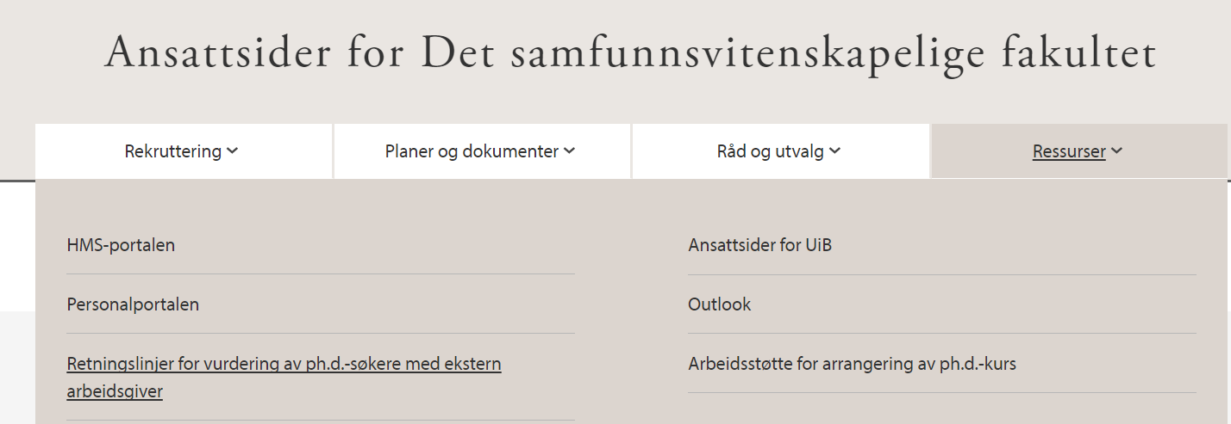
Asked to be main supervisor and assess a project description?
Please check the guidelines. At the moment only in norwegian.

Slide 6

Path 2
Direct links to the regulations at the front page:

Slide 7
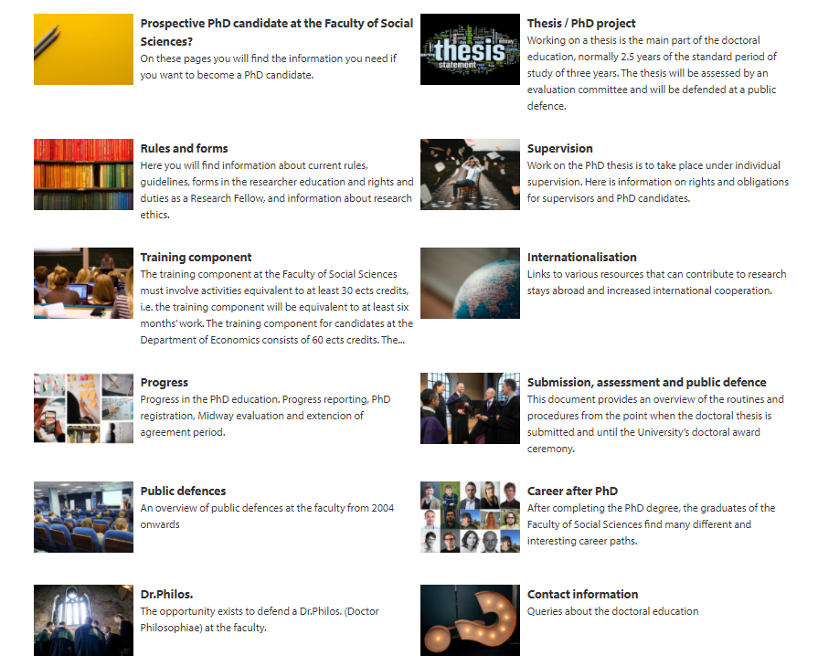
The most relevant pages for you as a supervisor are:
Training component
Progress
Thesis/ PhD project
Supervision
Submission

Slide 8
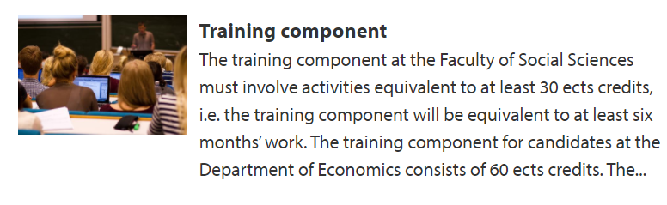
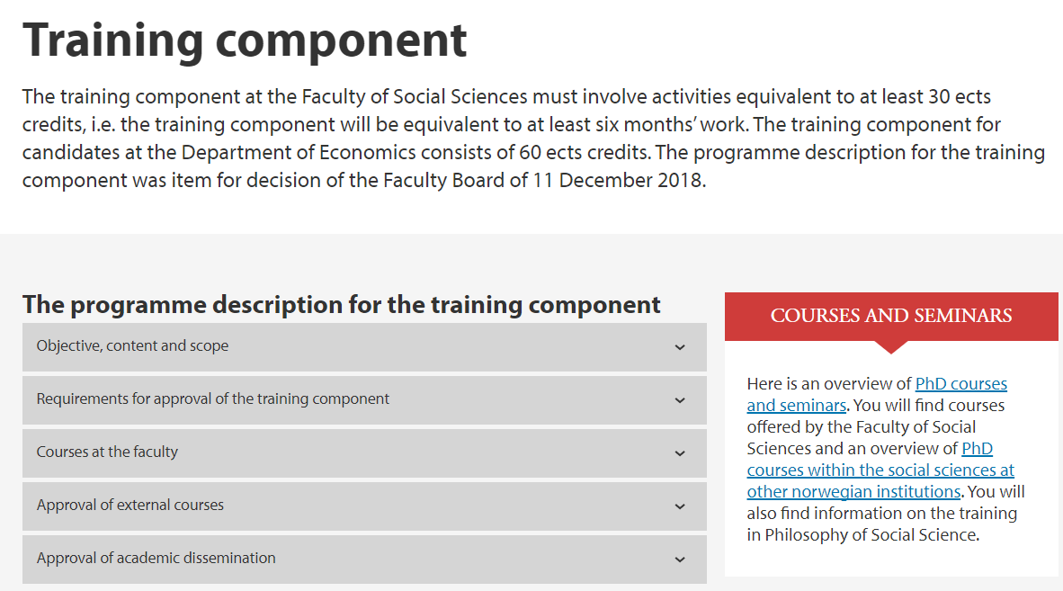
Training component
Here you find The programme description for the training component with information on:
Requirements
Role of the supervisor
Approval procedures

Slide 9

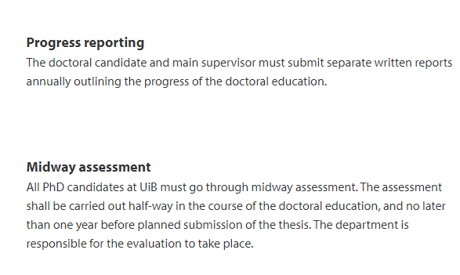
Progress
Main supervisors are involved in annual progress reporting and Midway assessment.

Slide 10

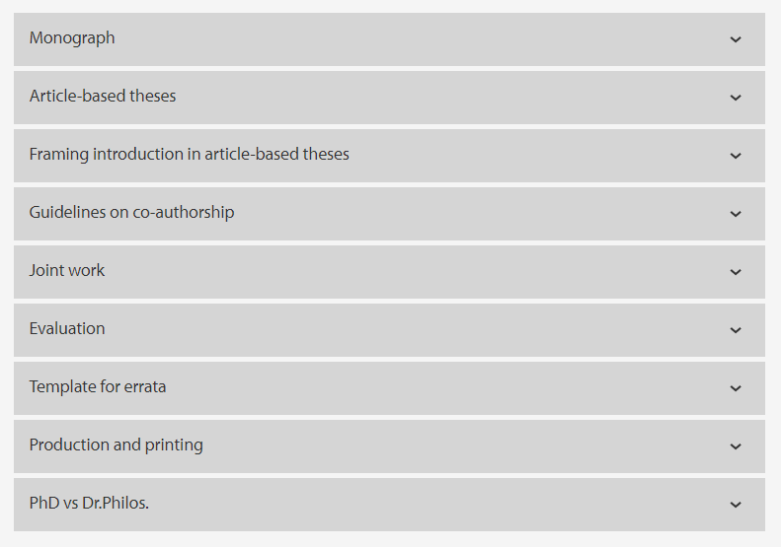
Thesis/ PhD project
Formal- and Quality requirements
Joint work
Practical information
Templates

Slide 11

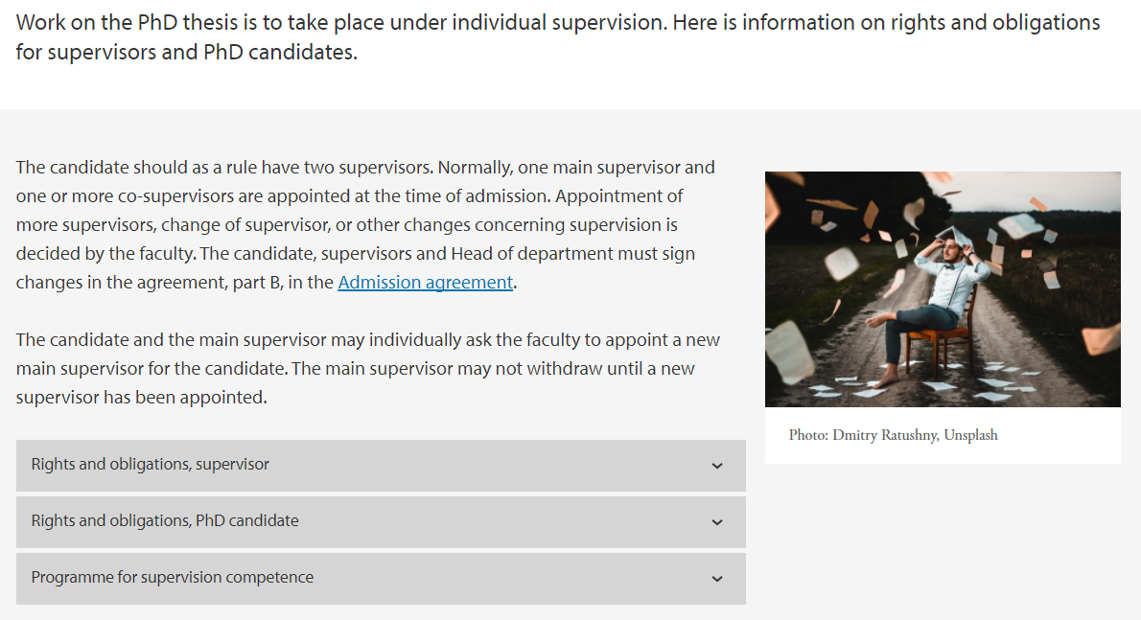
Supervision
What a supervisor is expected to do
What a candidate is expected to do
Programme for supervision competence

Slide 12

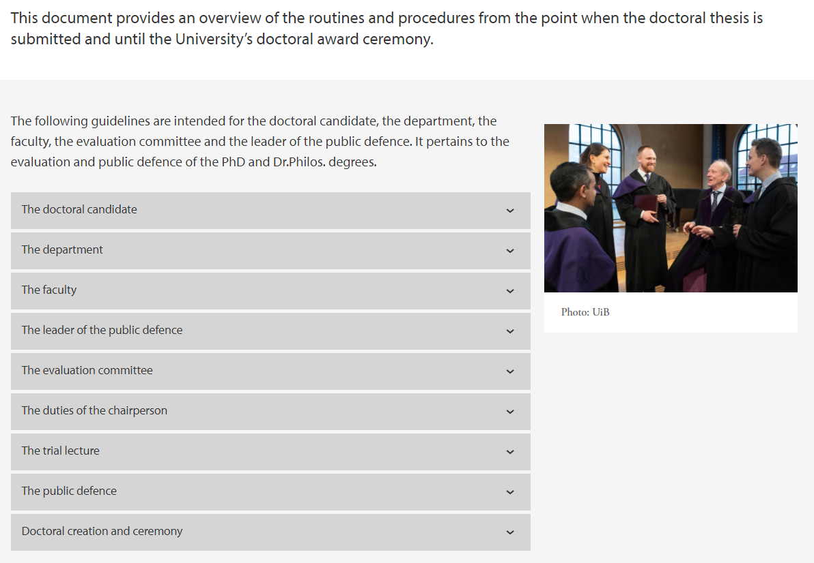
Submission
What you need to know about submission from the perspective of
candidate,
department
faculty
evaluation committee

Slide 13
uib.no

