Slide 1
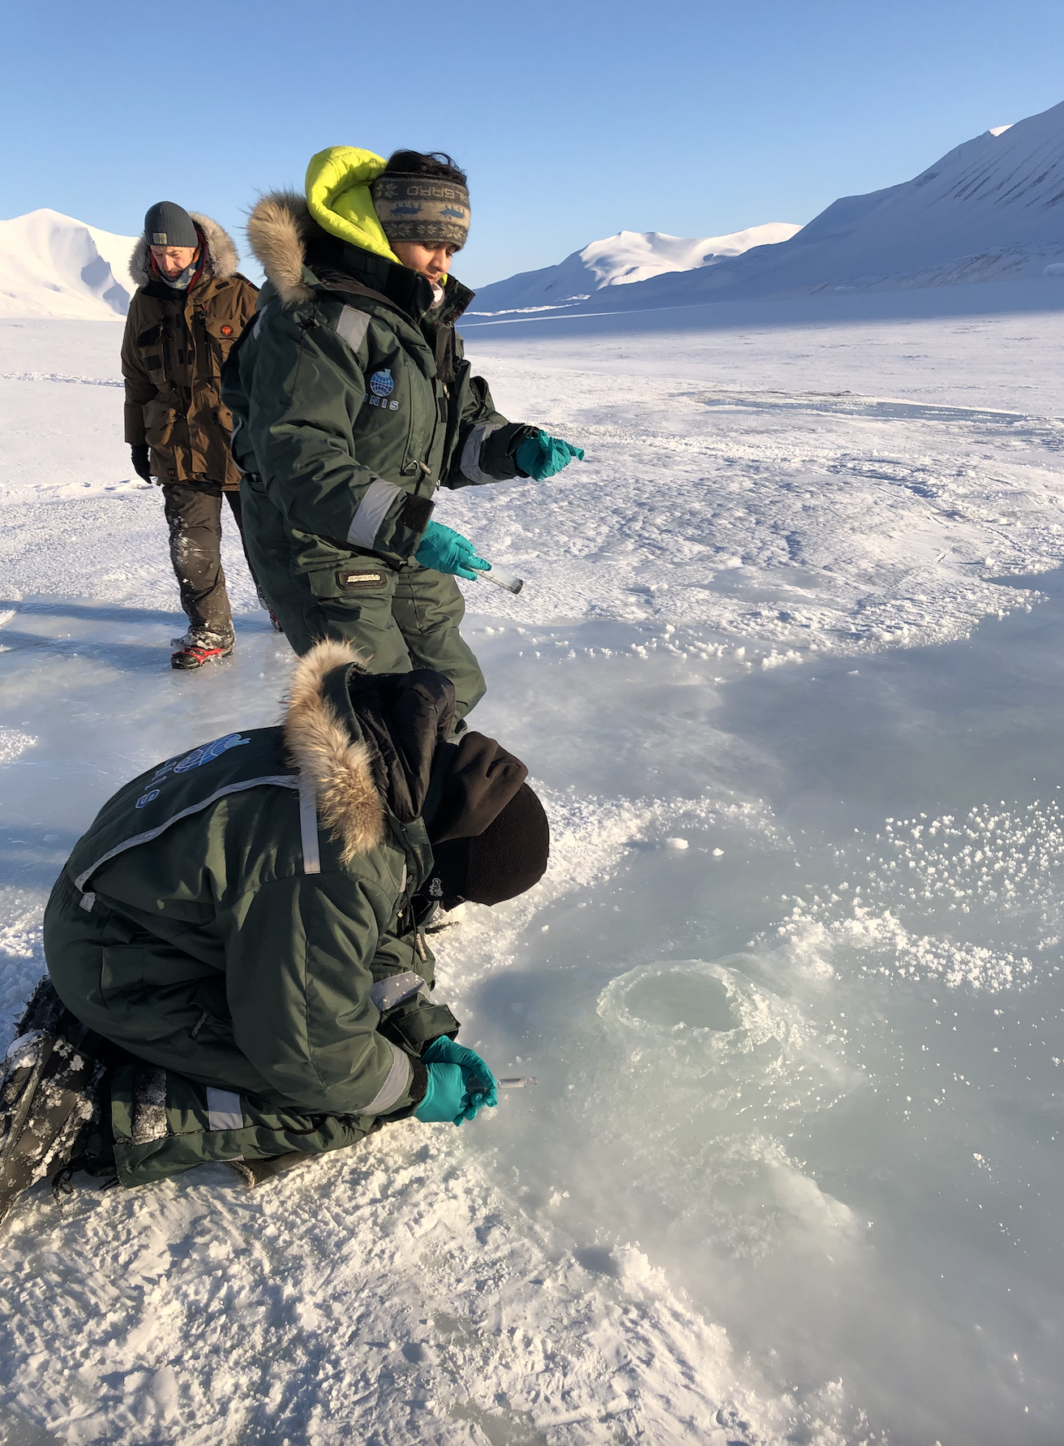
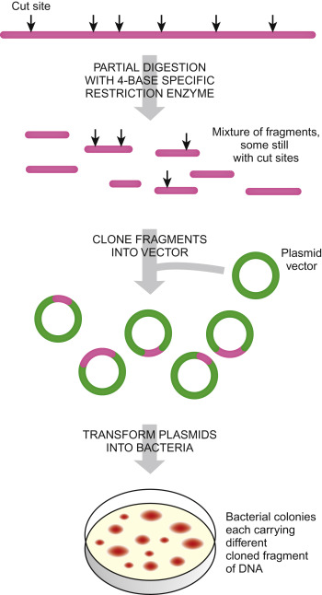
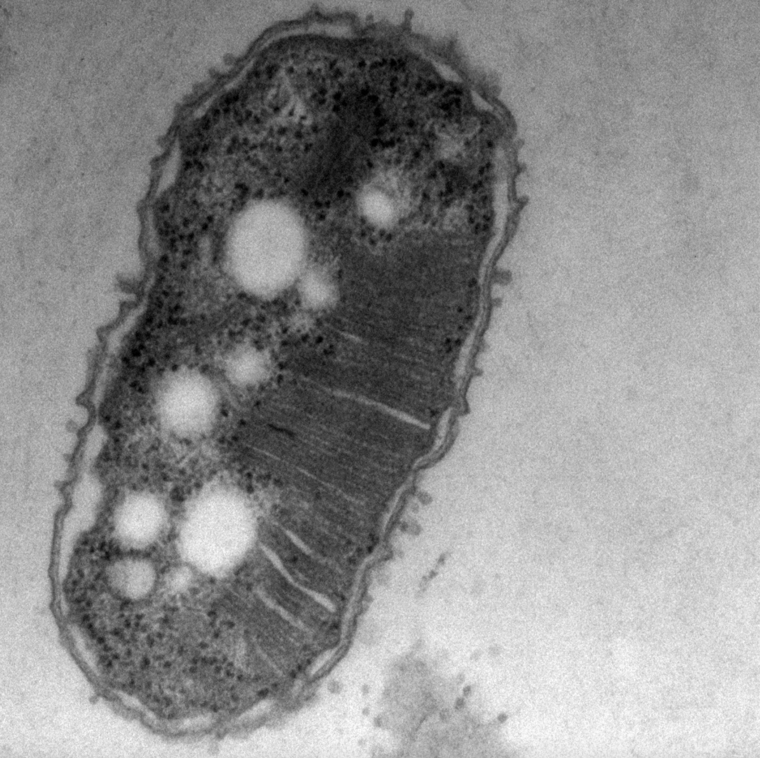
Methane oxidising bacteria – key to understand the fluxes of climate gases in the Arctic
Sampling water from pingos at
Svalbard
The release of methane from beneath retreating glaciers and thawing permafrost is a major source of uncertainty in the prediction of future greenhouse gas emissions from the Arctic. Presently we have no basis for predicting these fluxes on account of major uncertainty in the integrated physical, chemical and biological processes that govern how methane is produced, stored and released from these environments.
There is great urgency to understand these processes in cases where methane can avoid oxidation or consumption by methane oxidising bacteria (MOB). We have at the moment several enrichment cultures containing methane oxidising bacteria from pingos at Svalbard. We have reasons to believe that several of these MOB are novel and have not been described before, they are also true psychrophiles and therefor of large scientific interest. We therefore want to perform genome sequencing of these cultures. Before we do the genome sequencing we need to determine how many different isolates there are in each of the enrichments and also the novelty of these enrichments. To do so we will set up a clone library experiment.
This BIO 299 study will therefore be based on preparation of 5 clone libraries, picking 20 clones from each library and perform a sanger sequencing reaction. The results will be searched against a the NCBI database to determine the similarity of the isolate to sequences deposited in the database.
The DNA is already isolated and ready for being included in the clone library analyses.
Are you interested in this project; please contact Lise Øvreås (lise.ovreas@uib.no)
Preparation of clone library
Transmission electron micrograph of
MOB from Lagoon pingo, Svalbard.
The methane oxidation process is
localised in the membranes inside the cell
CH₄
CH₃OH

